Slide 1
UTA EE LABS
Hall Effect Sensors, Relays and Rotary Encoders

Slide 2
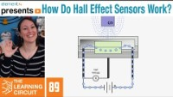
Nice video from Element 14

Slide 3
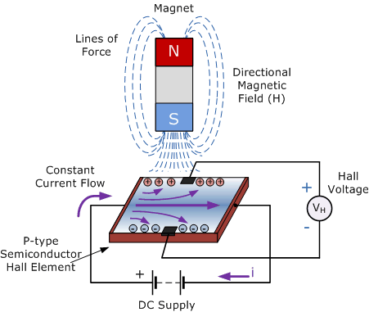
Hall Effect Sensors

Slide 4
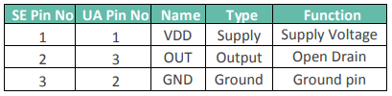
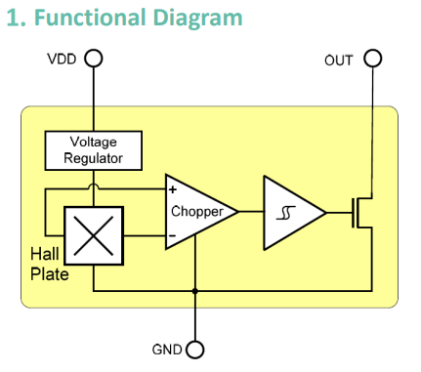
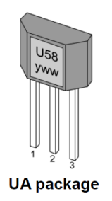
US5881 Hall Effect Switch

Slide 5
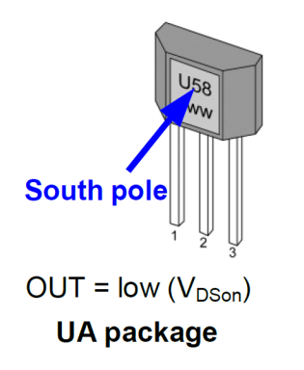
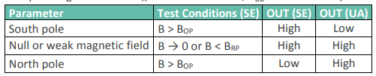
Properties

Slide 6
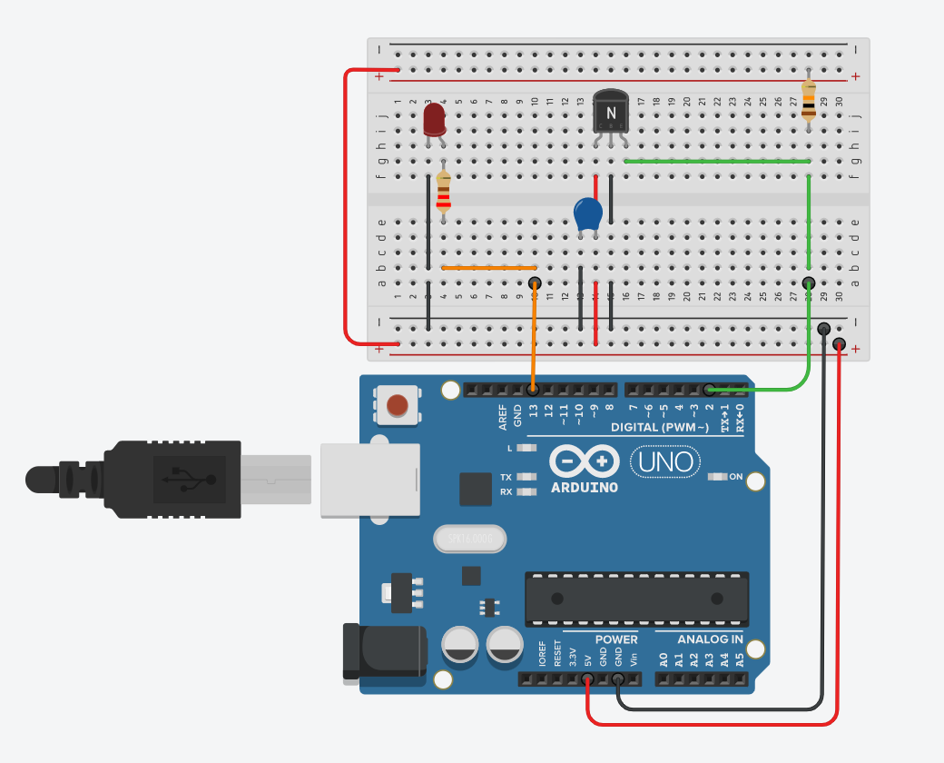
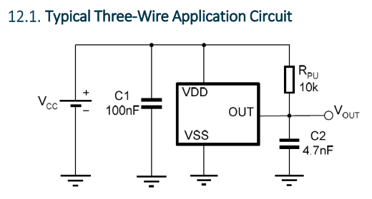
Let’s make the circuit

Slide 7
Here’s the code
/*
Code for Hall Effect Sensor
*/
const int LED=13; //The LED is connected to pin 9
const int HallEffect=2; //The Button is connected to pin 2
void setup()
{
pinMode (LED, OUTPUT); //Set the LED pin as an output
pinMode (HallEffect, INPUT); //Set button as input (not required)
}
void loop()
{
if (digitalRead(HallEffect) == HIGH)
{
digitalWrite(LED, LOW);
}
else
{
digitalWrite(LED, HIGH);
}
}
GitHub

Slide 8
Turn the LED on
Place the magnet toward the front of the Hall sensor.
Only the south end of the magnet will turn on the LED

Slide 9
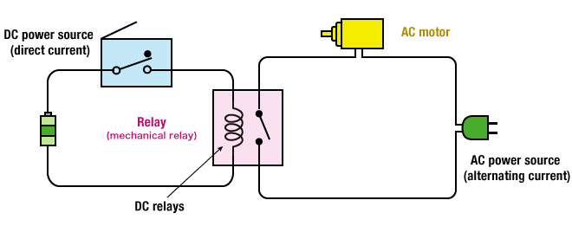
Relays

Slide 10
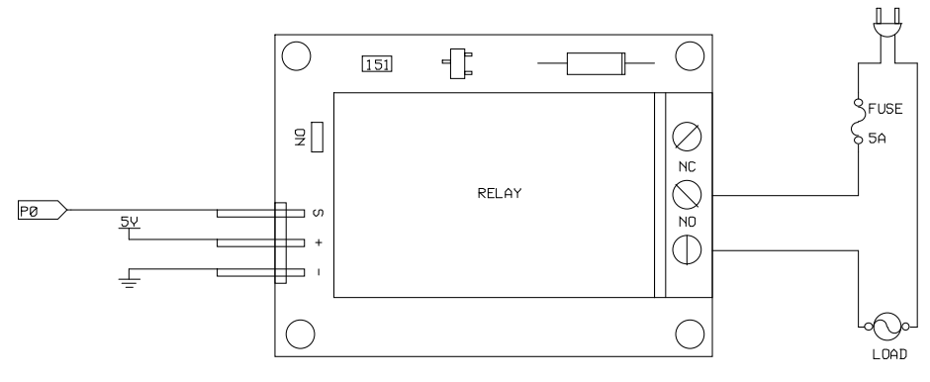
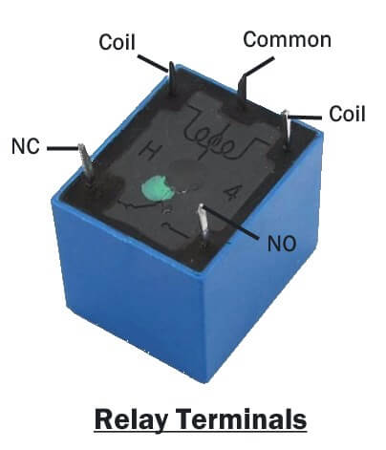
Relay Terminals
Choose the correct activation voltage – They come in 3,5,12,24 Volts
Ensure the relay can handle the max current of the load

Slide 11
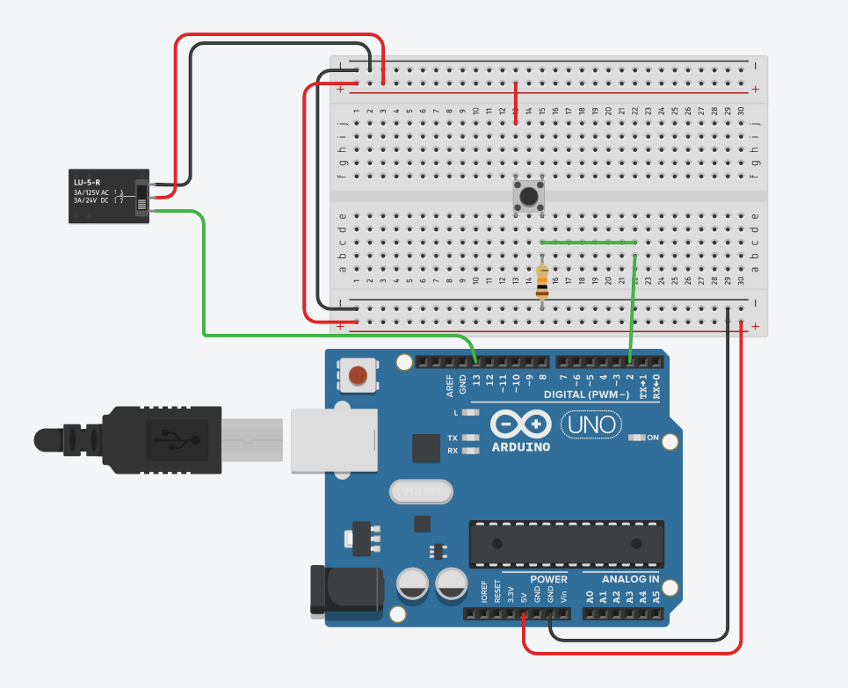
Quick circuit
10KΩ

Slide 12
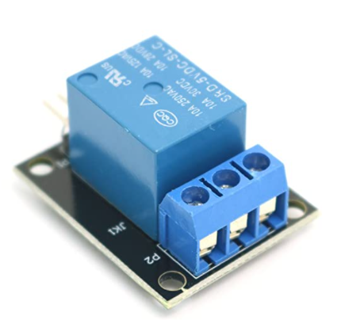
Get Code
Get the code from the UTA GitHub page and upload it to the Arduino.
Get the DMM Probes and measure the resistance of the output pins ( Screw Terminal Block) using the DMM
Figure out which is the common screw and which is the Normally Open screw and Normally Closed screw.
Do you recognized where you have heard the sound before?

Slide 13
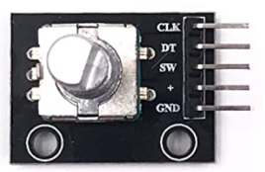
Rotary Encoders
Notes:
When you turn the knob, A and B come in contact with the common ground pin C, in a particular order according to the direction in which you are turning the knob.
When they come in contact with common ground they produce signals. These signals are shifted 90° out of phase with each other as one pin comes in contact before the other pin. This is called quadrature encoding.

Slide 14
We’ll just use 5 Male to Female jumpers for this one
Use the code to figure out the pin numbers while referencing the Rotary Encoder Pin names.
GitHub code

